Slide 1
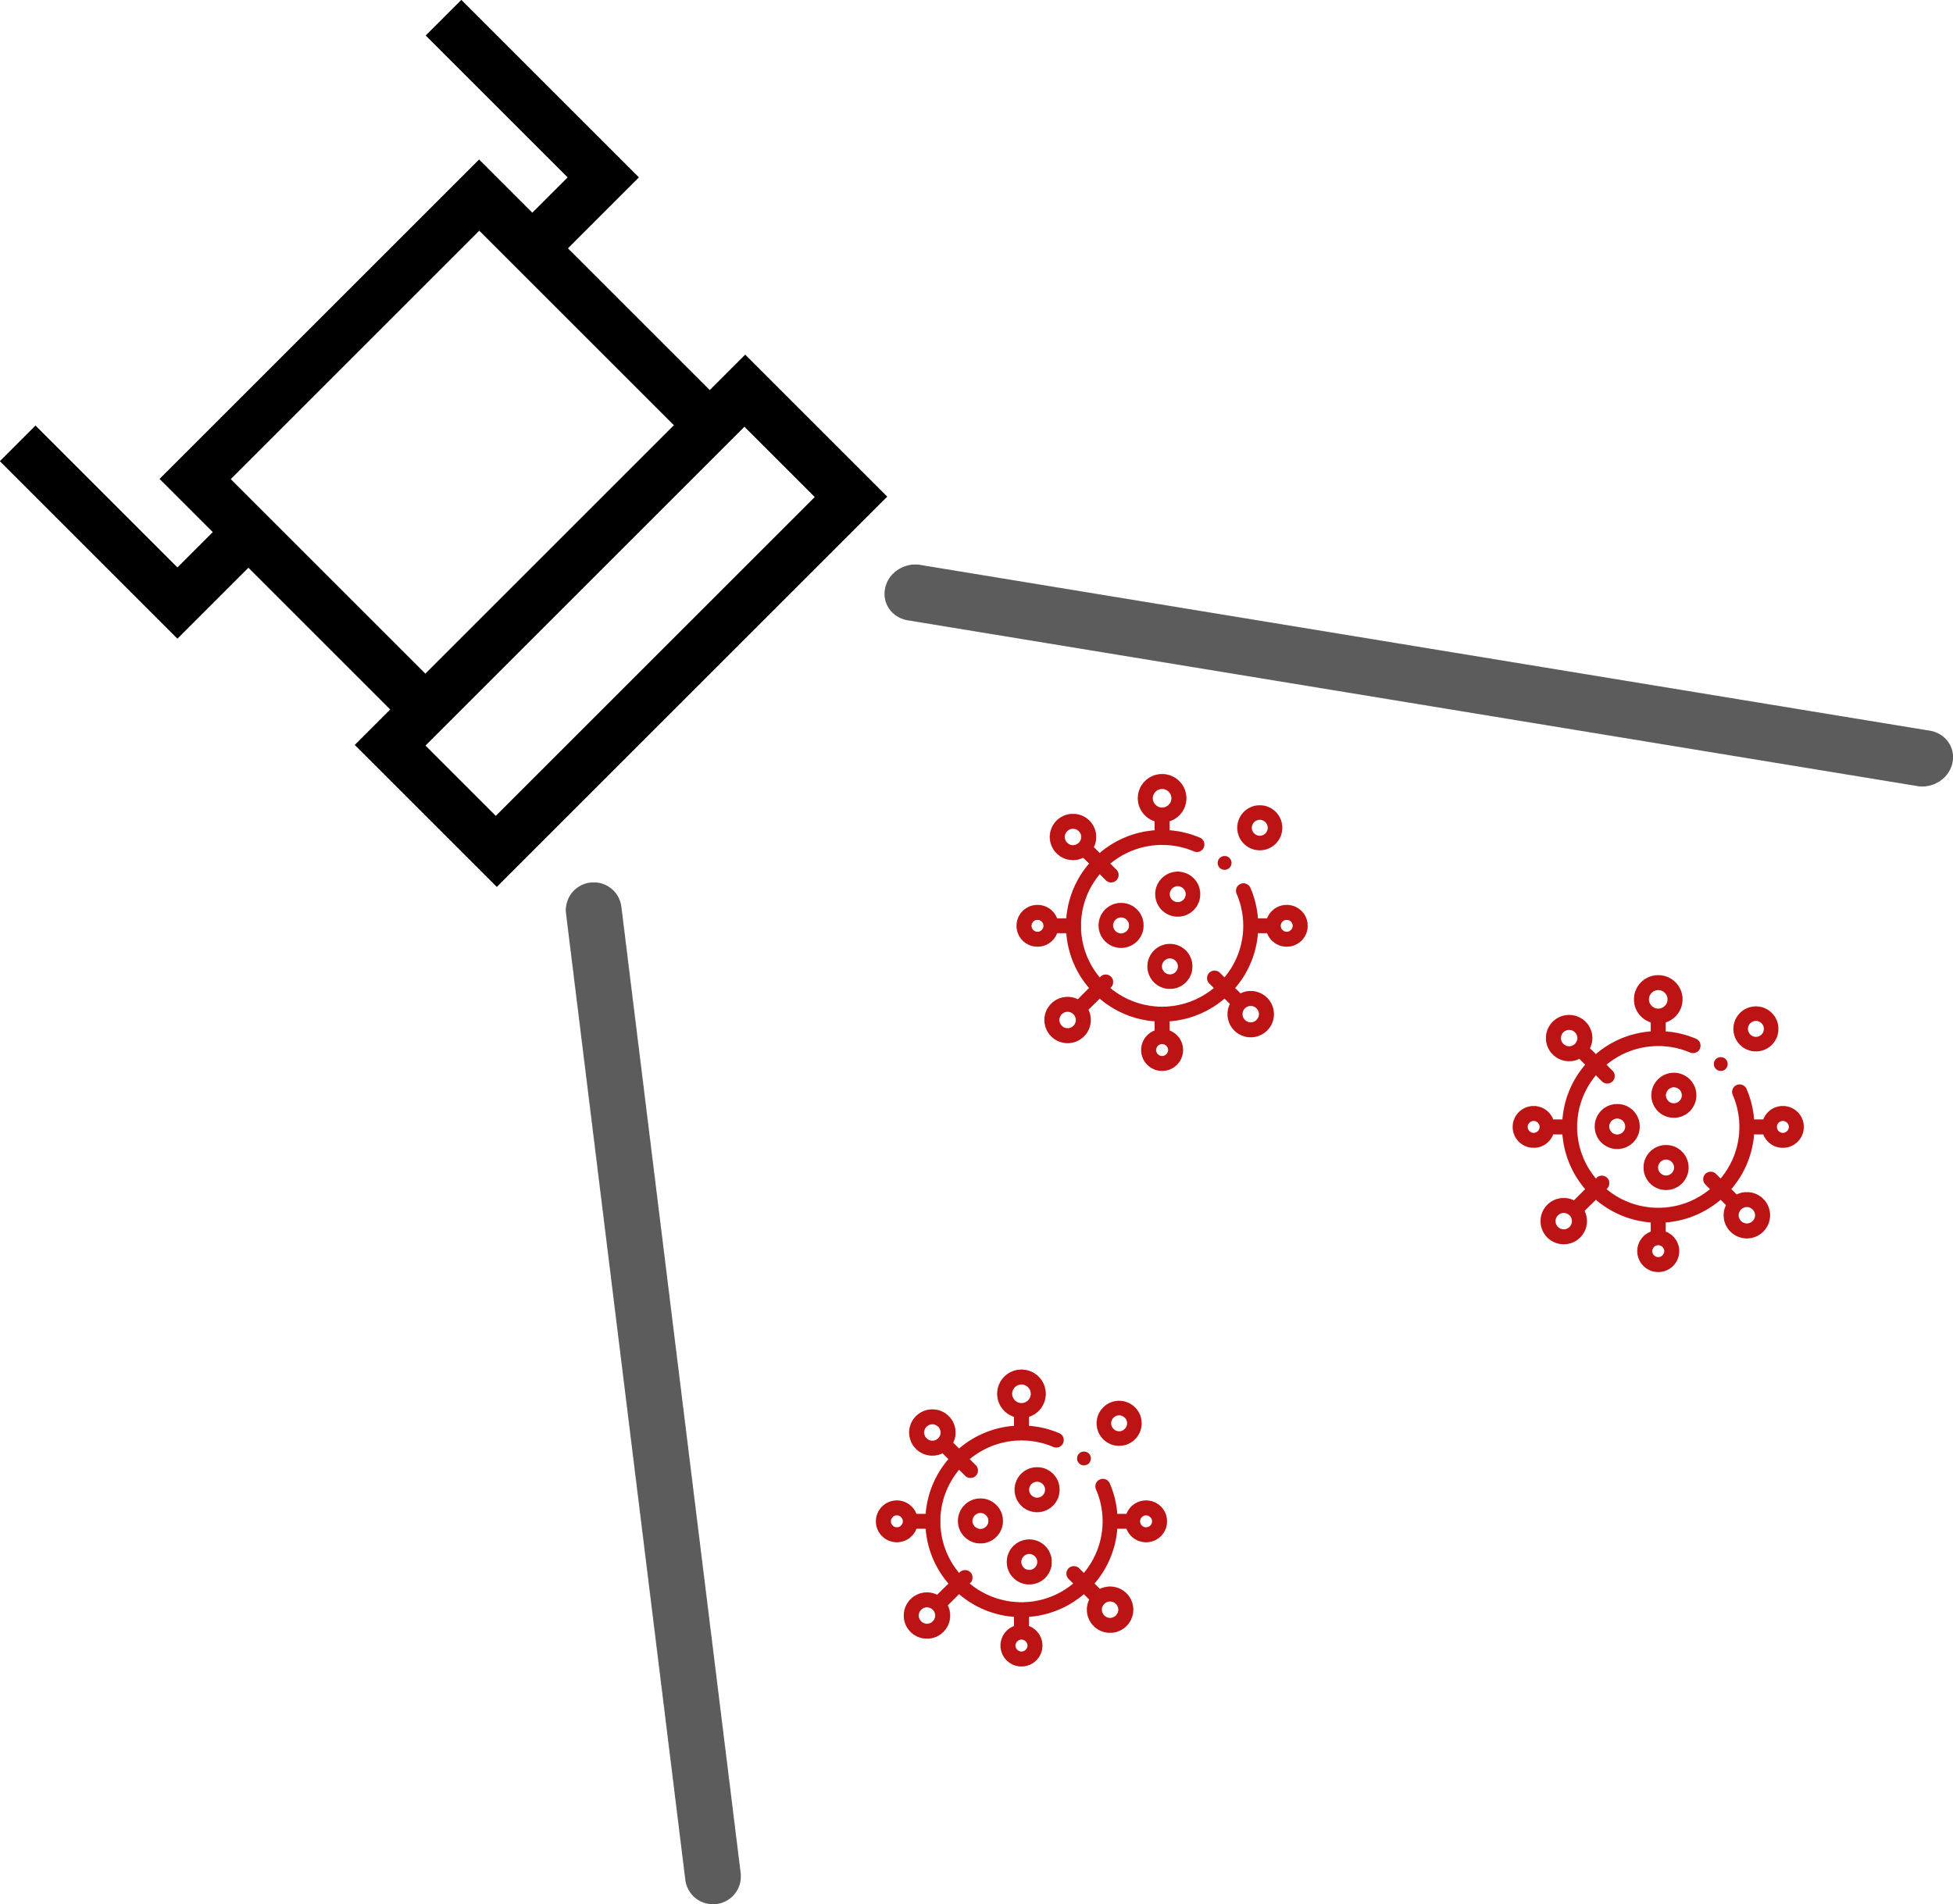
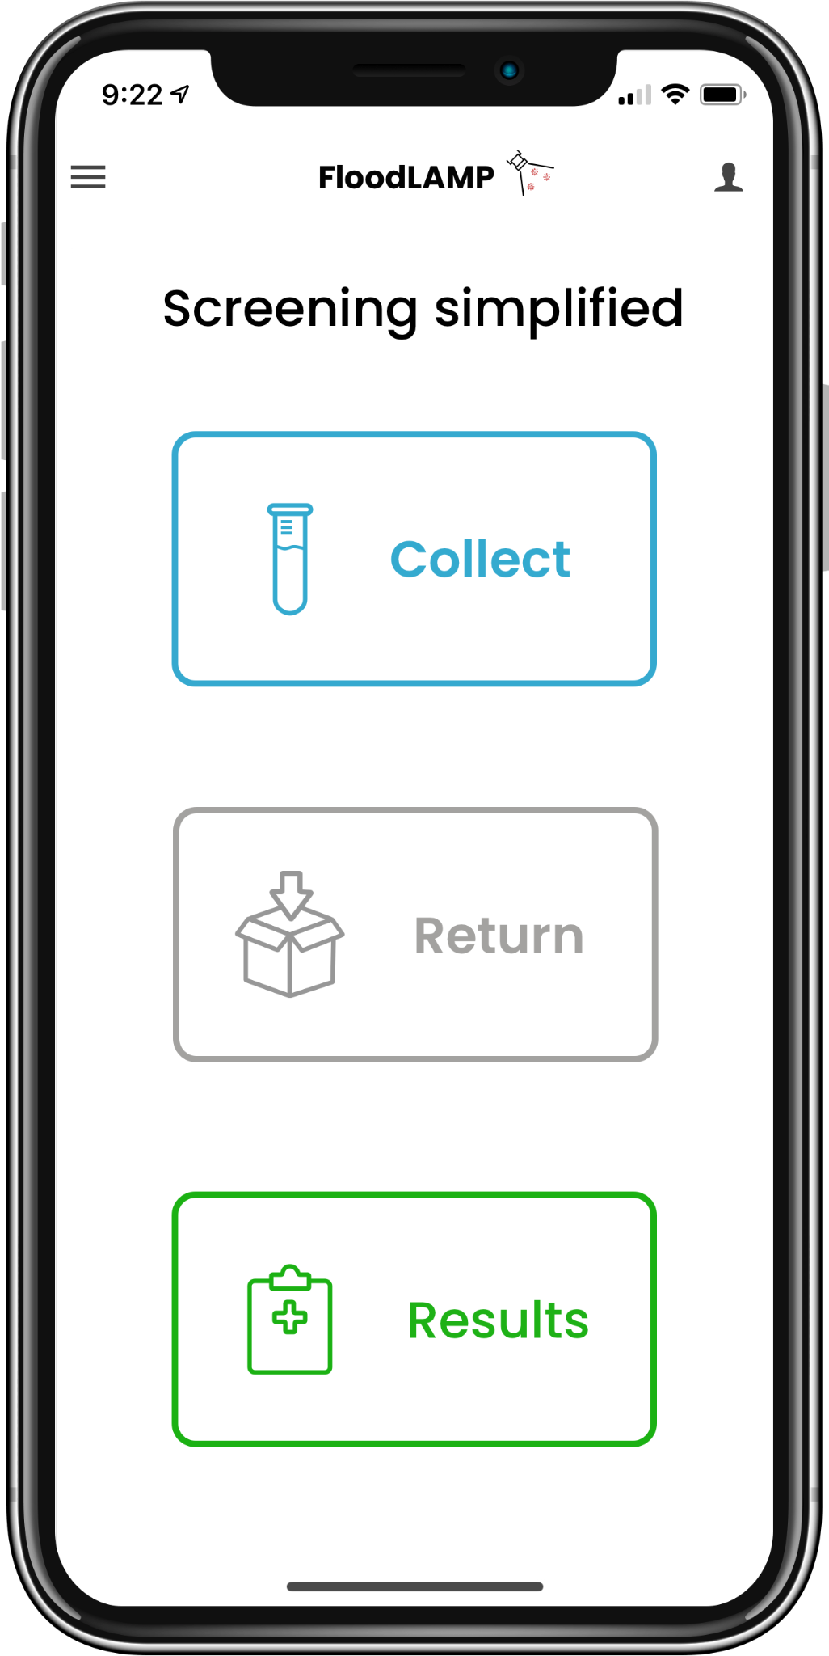
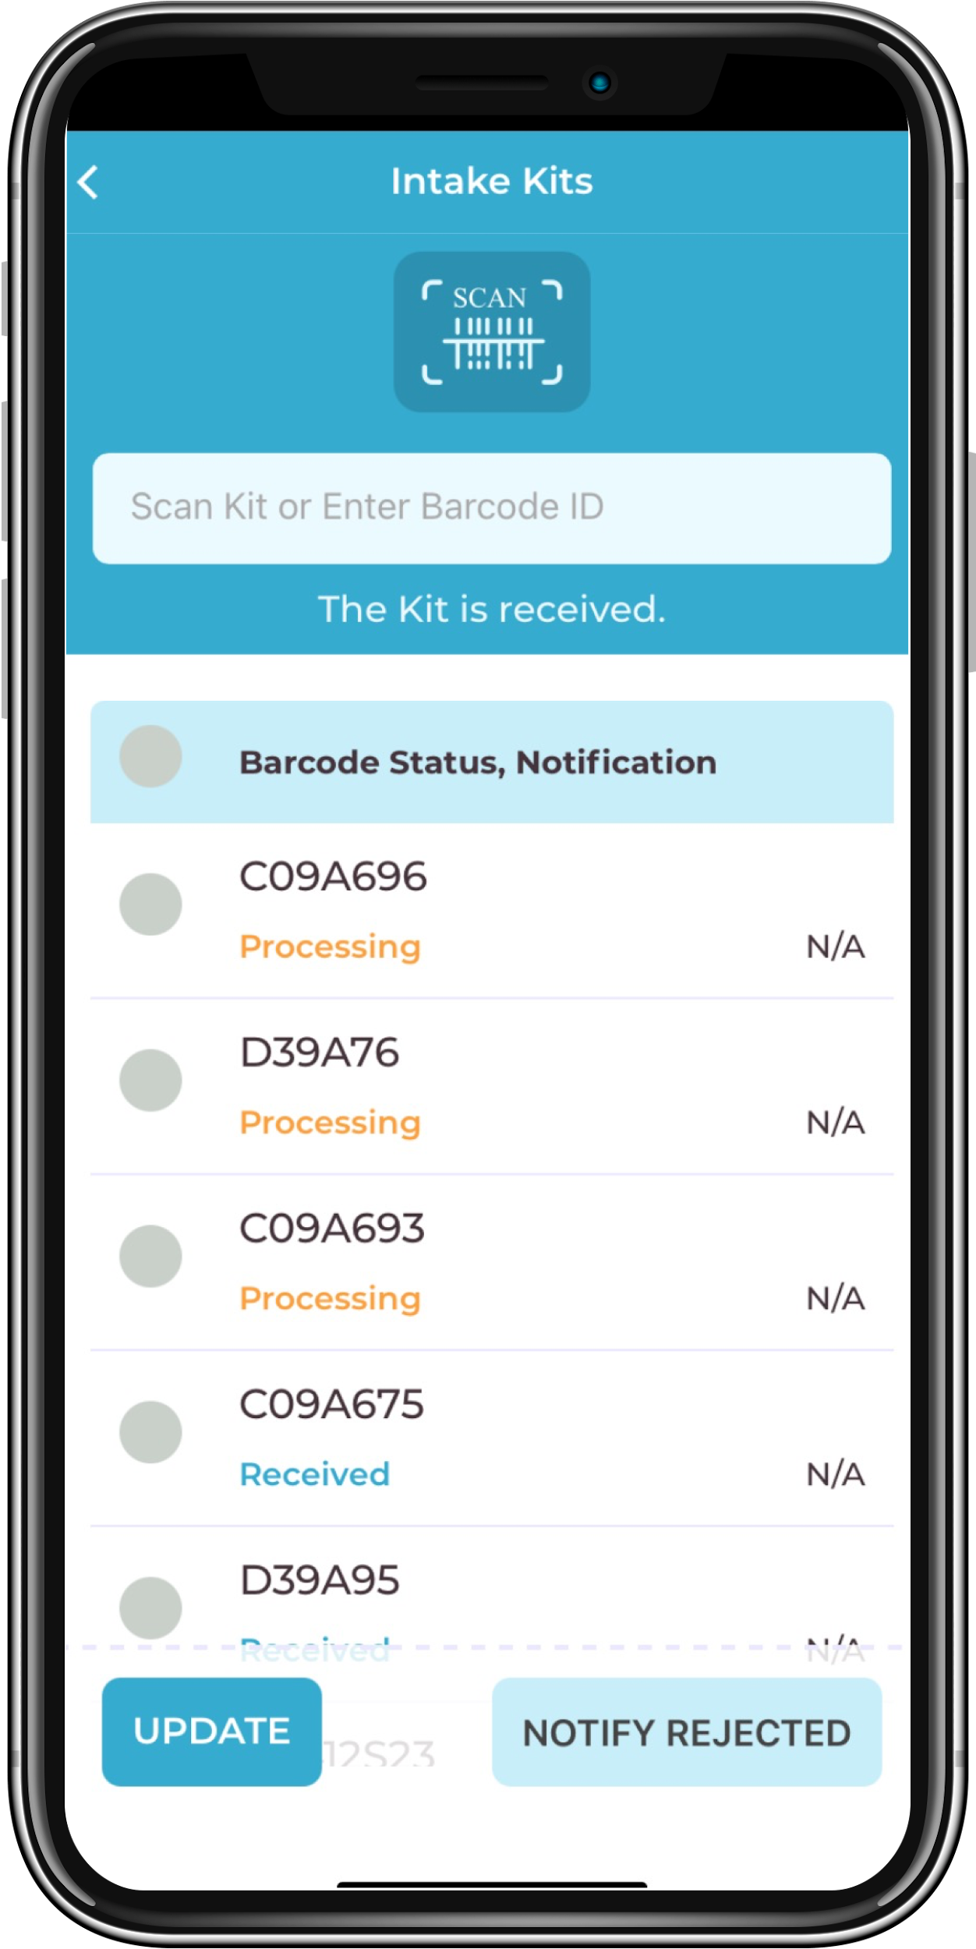
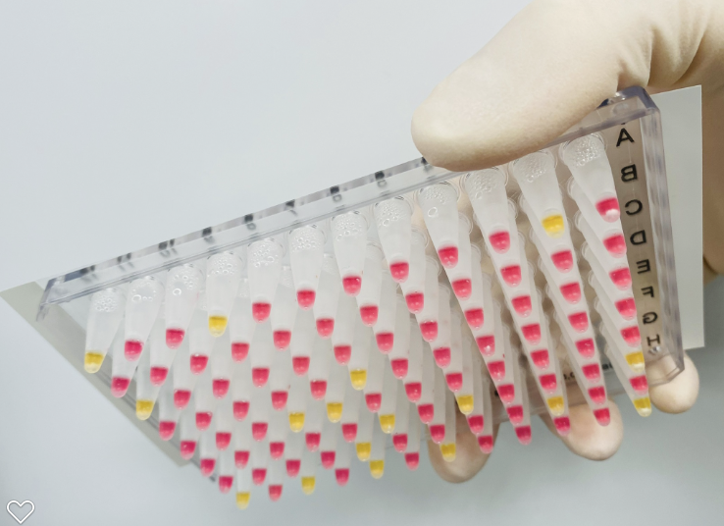
FloodLAMP Rapid Response Molecular Screening Network
Randy True (randy@floodlamp.bio), FloodLAMP Biotechnologies, PBC
Objective:
FloodLAMP's mission is to improve global health and resiliency through universal access to rapid molecular testing. Our near term objective is to deploy hundreds of sites delivering easy to use, flexible, fast turnaround COVID surveillance screening, to drive durable adoption in the communities most in need. We have developed a key capability that has been missing in the testing arsenal, one that can help realize the enormous potential of the field of diagnostics in ending this pandemic, preparing for the next one, and improving human health globally.
Description of effort:
Fully integrated turnkey surveillance programs comprising all equipment, consumables, test kits, pooled collection kits, digital tools, training, and support;
Systems cost of $2K give 20K/day max capacity, at low cost of <$2 per person (including labor);
Currently 8 systems deployed with EMS departments in 3 states, 11 staff trained to run test (5 with no experience), 4,700 people screened, 4 unknown positive cases detected, 32 known confirmed (100%), and no FP, no known FN;
Full EUAs submitted to the FDA for 2 tests, duplex PCR and colorimetric LAMP, as open source protocol EUAs, clinical evaluation by Stanford CLIA lab with 98% (PCR) and 90% (LAMP) sensitivity, and 100% specificity, pre-EUA submitted for clinical study of pooled home collection with FloodLAMP Mobile App, IRB for clinical and user factor study approved.
FloodLAMP Mobile App:
at home collection of family pools;
lightweight LIMS for tracking and reporting;
admin for mgmt, results, and metrics.
QuickColorTM COVID-19 Test and Turnkey Screening Program:
instrument free rapid molecular test,
2 hrs to setup and validate site,
10K+/day throughput at <$5K cost.
Benefits:
Scalable and replicable high quality molecular screening, deployable anywhere;
Rapid response to hot spots: 10K/day capacity bringup in 24hrs;
Outbreak risk reduction and disease suppression in high-need communities;
Acceleration of return-to-normal and economic activity;
Increased adoption over DIY antigen tests through convenience to end user;
Improved mitigation effectiveness of pooling at the family/household level;
Establishment of critical new regulatory paradigm - the generics of diagnostics through open source protocol FDA authorized tests, LAMP primer standards, and point-of-need flexible public health testing.
Challenges:
Regulatory barriers - access to FDA review as a startup;
Supply chain and staffing;
Educating the public and political leaders of the benefits of frequent screening.
Maturity of Technology:
Demonstrated real world success of full programs at multiple sites;
Test system clinical evaluation successful and FDA EUA validations completed;
Patent filings and licenses in place to secure control of key IP;
Pilot manufacturing of test reagents (40K reactions/day);
Reagent supply partners in place (LGC Biosearch and New England Biolabs);
Quality system and training program in development.
Major Milestones:
Milestone 1 - Bring up 3-5 Local Sites for 10K people in 2-3X weekly screening:
Expand from anchor sites at schools, first to families, then local businesses;
Partner with community organizations for outreach and communication of benefits to drive sticky adoption.
Milestone 2 - FDA open source protocol EUA's for pooled direct LAMP and PCR:
Complete asymptomatic clinical trial with enrichment strategy;
EUA for DTC pooled collection kit using FloodLAMP Mobile App;
Quality and training systems completed;
U.S. FDA EUA enables global distribution and copy cats.
Milestone 3 - Full suite of open source resources:
Modern website with all information, tools, products for various scales;
Includes quality and training systems.
Milestone 4 - 5M tests deployed:
Key reagents are in-hand, ready to kit and distribute.
Proposed Funding:
Phase 0: 1 week - deep dive due diligence;
Phase 1: 2-4 weeks - workplan incl Milestone 1 and TBD based on feedback;
Phase 2: 2-6 weeks - workplan incl Milestones 1, 2, 3 and TBD based on feedback.

